Slide 1






SIP
Insights on QGC
Summer Internship Program presentation.
Siddharth Pal
Table of Contents
TexMin

Slide 2
SIP(2nd year)
01
Report
02
File Structure
Daily Report of what I did.
Elaborate File structure of QGC.
03
VyomGCS
04
Conclusion
Final Product feedback
Table Of Contents

Slide 3
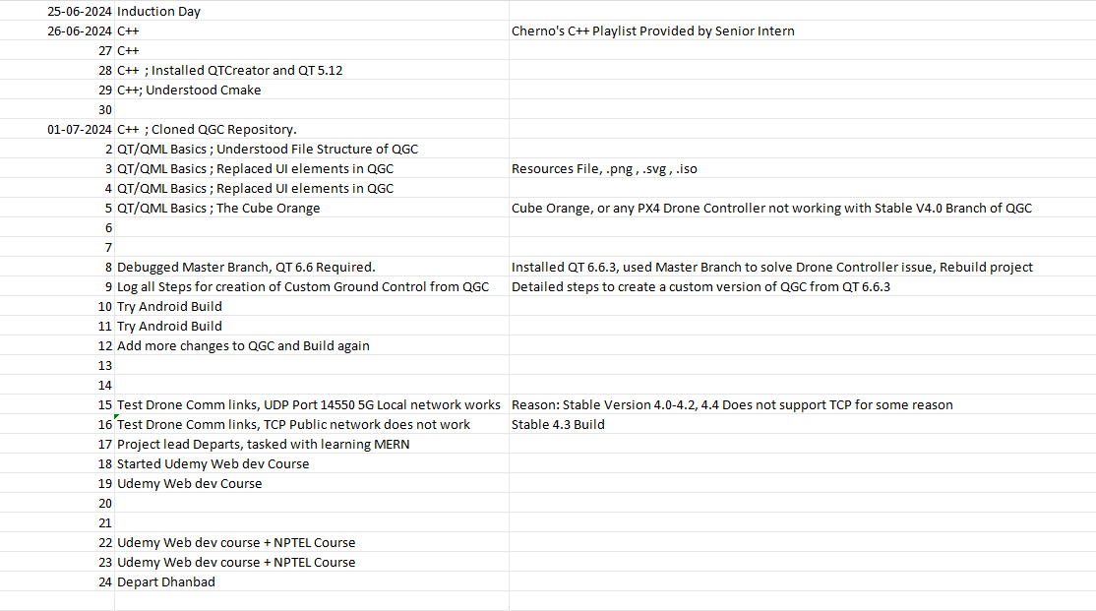
Report
Day 1-5 : C++
Day 5-9 : QtQML-Started VyomGCS Build
Continued learning with regular changes done to QGC

Slide 4
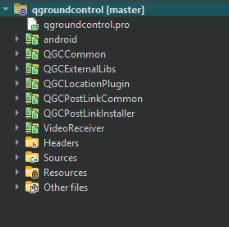
File Structure of QGC
There are almost 26554 Files in the QGroundControl Project Folder.
QGroundControl.pro : is the main project file, which intitializes the App Name, and starts the project, defines constants.
qgroundcontrol.pri : are resource files present in every folder denoting where from resource need to be taken from.
C++ Files are in every folder for every functionality, but the common, like main C++ Files are in the Sources folder.
Headers folder: is used to declare functions, and to link C++ files.

Slide 5
Resources file has all the resources, the ico files, png, and svg files which are used in the QGC Apps in various places in the Application.
The QML Files are stored in the src folder.
The Project is accessed and altered in the IDE of Qt Creator.

Slide 6
VyomGCS
Feedback from team, and process of creation.
In this slide I will tell about VyomGCS.
Due to terrible QGC documentation, previously 2 months have been invested in TexMin without any Vanilla build of QGroundControl. In my initial days of learning C++, I also kept researching about Qt Versions and used to do trial and error to find ways to make a custom version of QGC.
A Log of QGroundControl Customization for Vyomchara (WINDOWS)
1.Download Git for Windows 11. You require to have GIT Bash Terminal.
2.Download C++ with Microsoft Visual Studio.
3.Download and Install Qt 6.6.3

Slide 7
4.Clone Master Branch of QGroundControl (QGC) From mavlink/qgroundcontrol: Cross-platform ground control station for drones (Android, iOS, Mac OS, Linux, Windows) (github.com) using the following command in GIT Bash.
git clone -b master --recursive https://github.com/mavlink/qgroundcontrol.git
5.Change Variable QGC_APP_NAME from QGroundControl to VyomGCS in the file qgroundcontrol.pro.
6.Change line 182 in src/QGCApplication.cc from "%l Daily" to "%l".
7. Replace Logos
- Replace the following logos in the resources folder with the VyomGCS logos:
- QGCLogoBlack
- QGCLogoFull
- QGCLogoWhite
- Ensure the logos are in `.svg` and `.png` formats.

Slide 8
Update Icons
- Replace qgroundcontrol.ico with the VyomGCS logo (16x16).
- Replace qgroundcontrol.png with the VyomGCS logo (512x512).
9.Removing QGC Name occurrences further:
- Modify HelpSetting.qml:
- Change names and provide links from line 37 to line 65.
- Modify src/UI/preferences/RemoteIDSetting.qml:
- Change line 933:
"Note: Even if this box is unset, VyomGCS …”

Slide 9
Note 1: Stable V4.0 uses Qt 5.15.2 and is stable, but does not support Orange Cube Drone Controller.
Note 2: There is a weird message about unsaved changes. Saving causes errors, so avoid saving to prevent issues.
10.Open the Project file in QT Creator 13.0.2 using the qgroundcontrol.pro file let it read.
11.Build after all these steps, Warnings are normal using Qt 6.6.3 MSVC 2019 64Bit in Release mode. The Build will be done in Build\6_3-Release\staging where the .exe file will be made.
11.After testing the application make a installation file using Inno Setup Compiler.

Slide 10
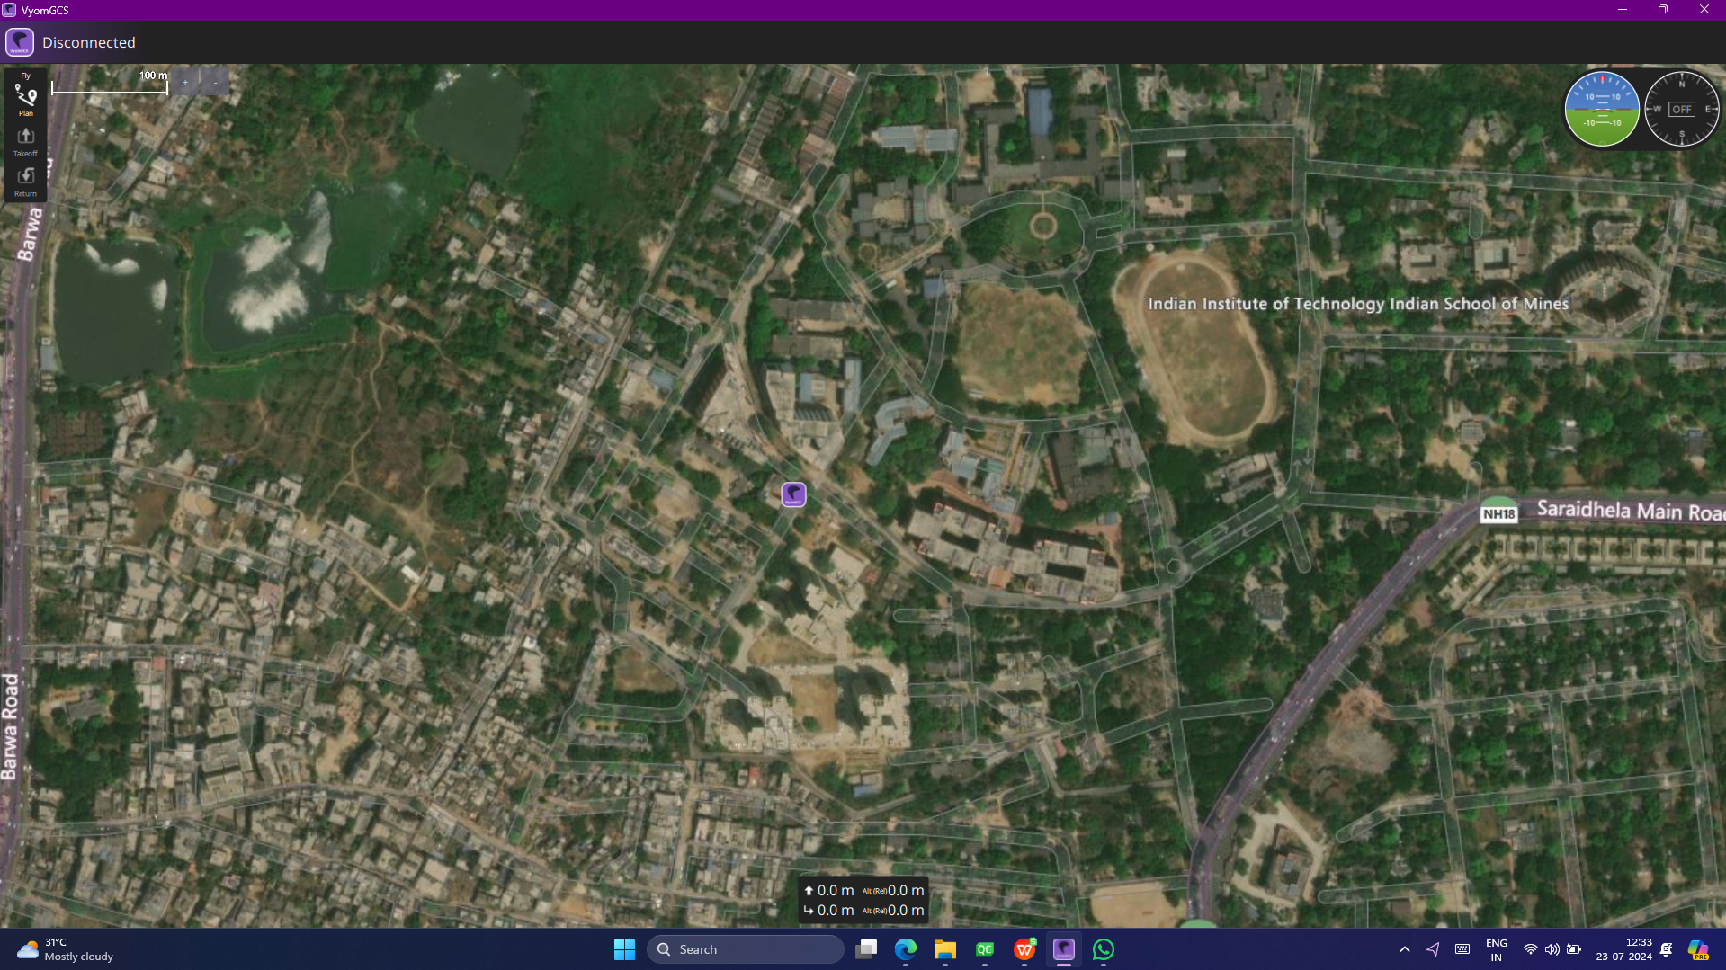
Application Startup

Slide 11
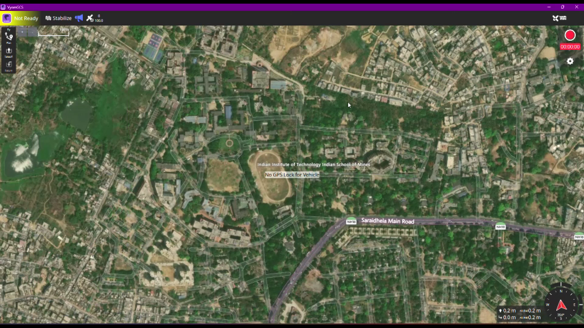
After Connection

Slide 12
The VyomGCS is used regularly by the team. It works with wired connection as well as wireless over the local 5G network. VyomGCS detects and updates firmware of all drone controllers used here.
I have built multiple versions of VyomGCS Already, once with Stable V4.0, stable V4.3, and master branch.
Stable V4.0 does not support hardware requirements.
Stable V4.3 currently being tested.
Master Branch supports our hardware but is unstable. Constant testing and rebuilds are being done.
Thank You
-Siddharth Pal

